Slide 1
Spatiotemporal modelling & automated in-situ sensors to monitor Harmful Algal Blooms(HABs) Case Study-Lake Victoria
Presenter:
Name: OKELLO, JACOB OKOMO
Reg. No: ENC222-0149/2017

Slide 2
Introduction
Harmful Algal Blooms (HABs), a phenomena which turns water bodies dark blue-green due to eutrophication; potentially harming humans and animals e.g., massive fish deaths, etc. (Santoleri et al., 2003), WHO
Development, stability, and density of the phenomenon affect some environmental factors Lake Surface Air Temperature (LSAT), Sea Surface Temperature (SST) (Tang et al, 2006)
Hence, quantifying the spatial distributions of HABs in L. Victoria is of great significance, which requires high spatiotemporal monitoring. (Sitoki et al., 2012)
There however exists that niche to support the space observations with a near-real time geointelligent in-situ monitoring and reporting system.

Slide 3
Problem statement
The rapidly escalating demographics along L. Victoria riparian reserves has negatively impacted water quality through deposits of agricultural, industrial runoff and sewer refuse eutrophicating the said region. (Burkholder et al., 2006; MOH)
Deterioration in water quality initiates ecosystem conflicts, poor economic growth, reduced tourism, poor water quality furthermore baring achievement of SDG 6 & 14- Clean Water and Sanitation. (Hecky et al., 2010)
Coupling wide spread spatiotemporal monitoring, and automated in-situ sensors will play a big deal in return. This would inform the Govt. and the general public the affected zones, calling for immediate remedy actions.

Slide 4

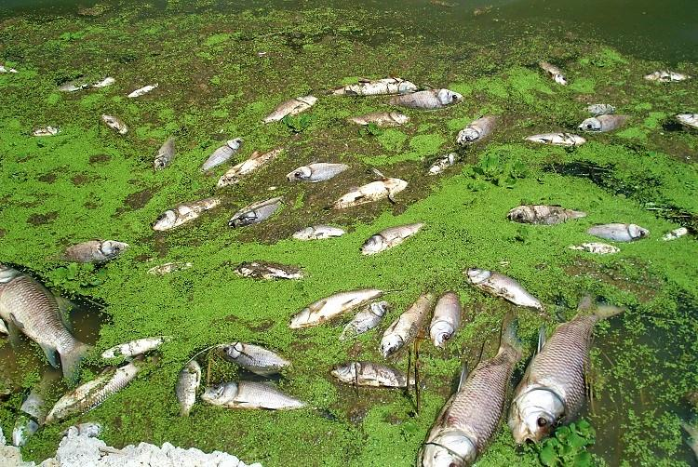
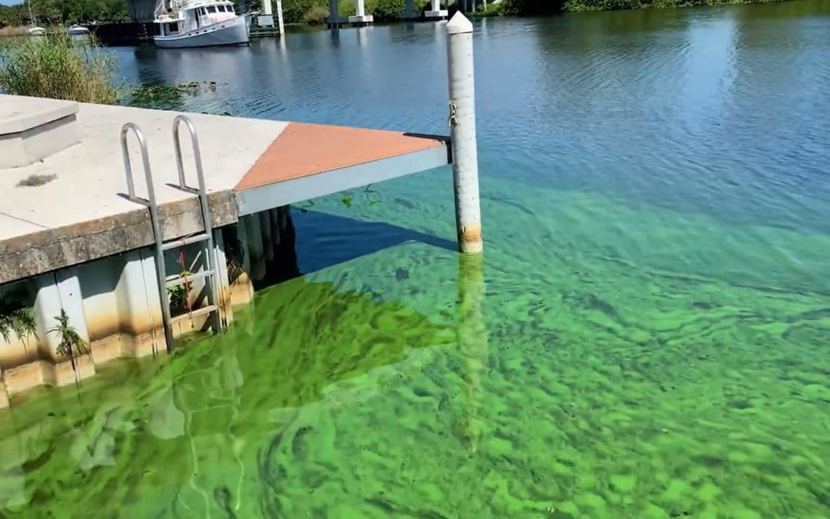
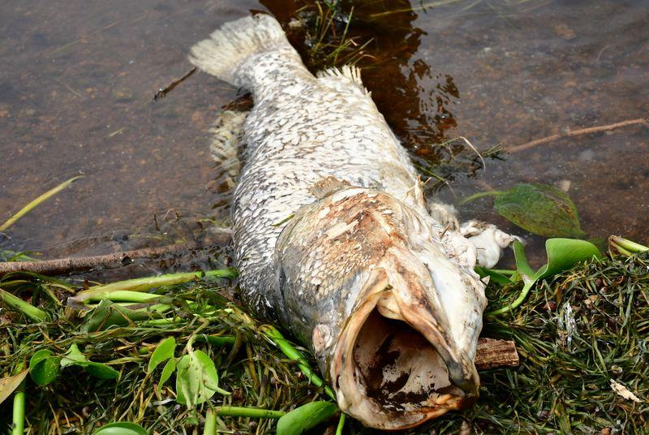
Justification
Image Sources: Standard Media KE, KMFRI, allAfricawaters

Slide 5
General and specific objectives
To detect, monitor and report the occurrence of Harmful Algal Blooms(HABs) in Lake Victoria, Kisumu basin.
To monitor chlorophyl-a(chl-a) concentration from L8 OLI images.
To monitor Lake Surface Air Temperature(LSAT) from L8 TIRS images as another HAB indicator in L. Victoria.
To develop automated Internet of Things (IoT) in situ sensors, Applicable in near real-time to monitor and report geo-tagged Water quality data.

Slide 6
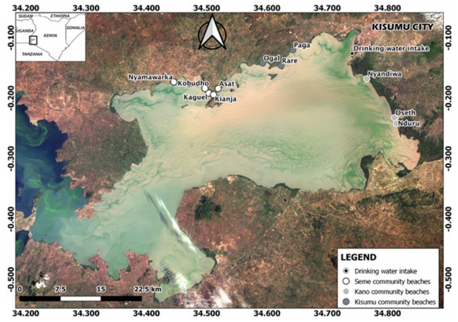
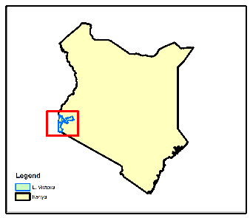
Study Area
NYANZA GULF
Homabay

Slide 7
Overall Methodology : Data and Materials
Data Type | Source | Role/Use
Landsat 8 OLI (30m, 16 days) | Google Earth Engine (2015-2021) | Spatiotemporal HAB Monitoring
Landsat 8 TIR (100m, 16 days) | Google Earth Engine (2015-2021) | Lake Surface Water Temperature Monitoring(LSWT)
Meteorological Data | Kenya Marine & Fisheries Research Institute-KMFRI (2015-2021) | Water Quality assessment
In-Situ Data | In-situ Sensors 2021 Onwards | Continued In-Situ Algal Monitoring
Tool/Material | Role | Availability
Google Earth Engine (GEE) | Geocomputation & Processing | Freely Available
QGIS/ArcMap, R & Python | Further Analysis & Maps | Free
Microcontroller & Sensors | In-Situ data Monitoring | Local Purchase
KiCAD | Design the Schematics & basic Circuits | Free & Open source

Slide 8
Automatic L8 Acquisition from GEE
TIRS Data
Landsat 8 images
OLI Data
TIRS B10
B5 NIR
B4 RED
B3 GREEN
B2 BLUE
NDVI
TOA DN to At-Sensor Radiance(Lλ)
Proportional of Vegetation(Pv)
Ocean Color Chl-a algorithms
At-Sensor Spectral Radiance to Brightness Temp (Tb₁₀)
Lake Surface Emissivity (LSE)ε
Validation
Estimate Lake Surface Air Temp (LSAT)
Objective 2
Objective 1
Below
Threshold
Above
Automatic Results Download
Process validation
Spatiotemporal Monitoring

Slide 9

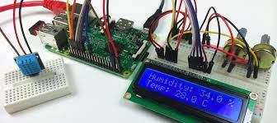


Overall methodology
Start
IoT Gateway
Ensure a secure connection via SSh
Upload in-situ data to reporter
Upload in-situ data to Processor
GPS
LSAT
Salinity Satus
No
In-situ data > Temp. threshold
Objective 3

Slide 10
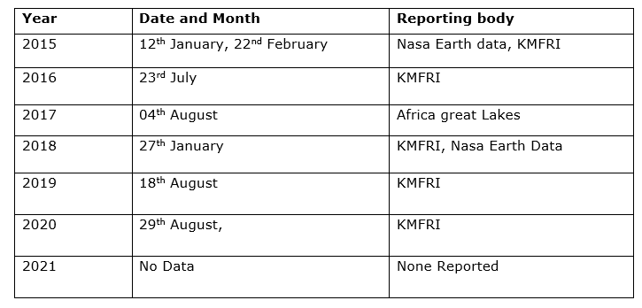
HAB reported dates, from 2015
Table 3: HABs reported in Lake Victoria, (KMFRI, NASA Earth Data)

Slide 11
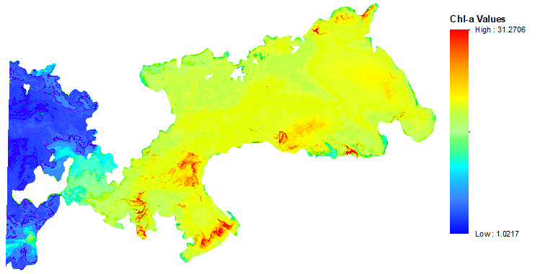
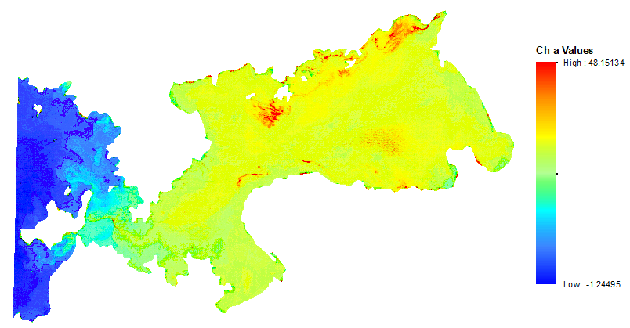
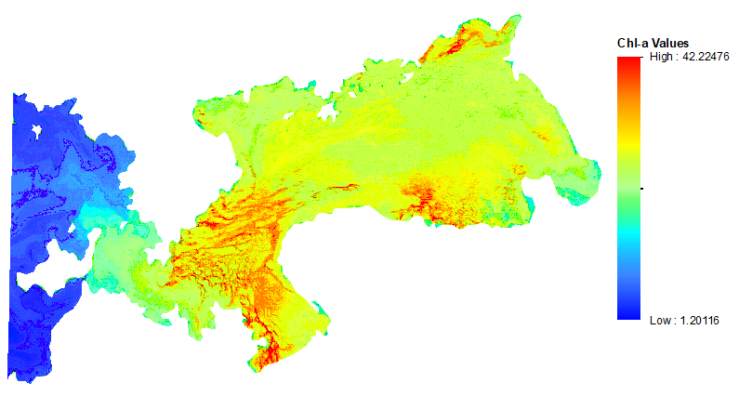
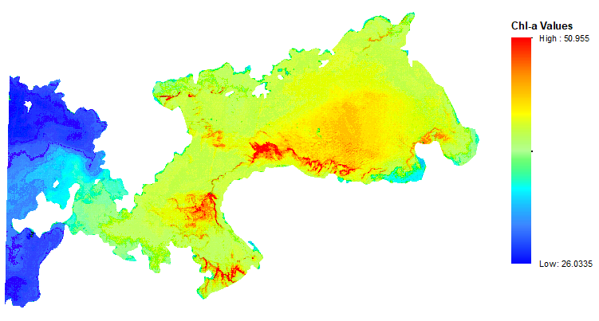
Results (a) : Chl-a Distribution Maps
12th January 2015 23rd July 2016
04th August 2017 27th January 2018

Slide 12
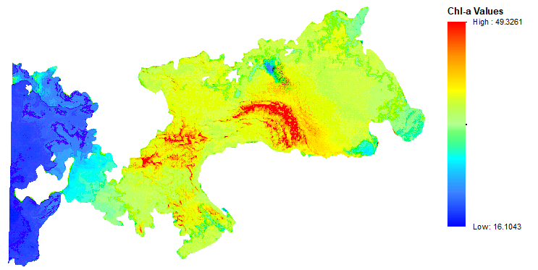
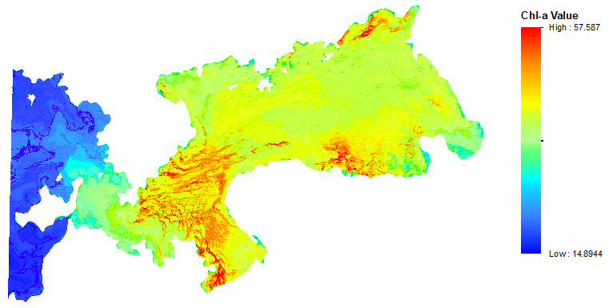
Chl-a Distribution Maps, Cont’d
18th August 2019 29th August 2020

Slide 13
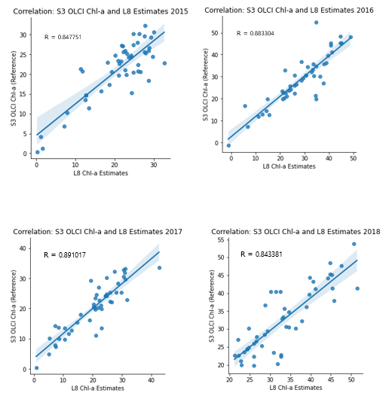
Accuracy Assessment of Chl-a Estimates

Slide 14
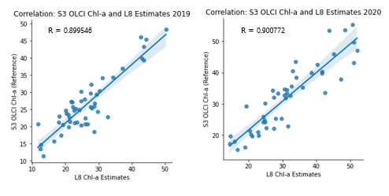
Accuracy Assessment of Chl-a Estimates

Slide 15
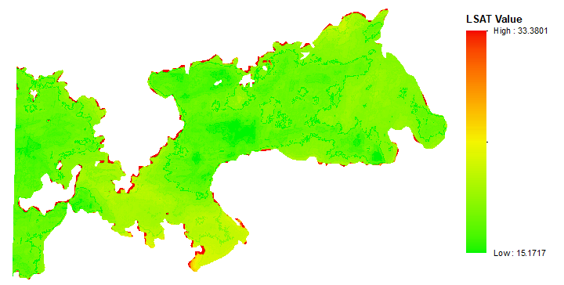
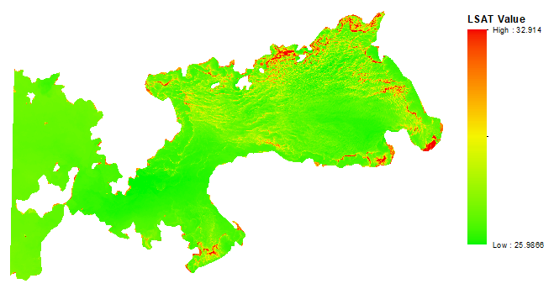
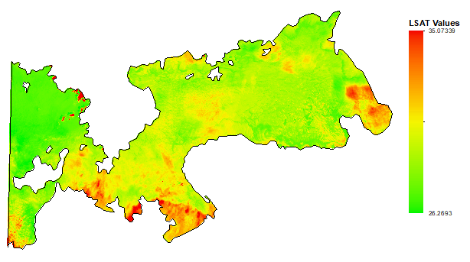
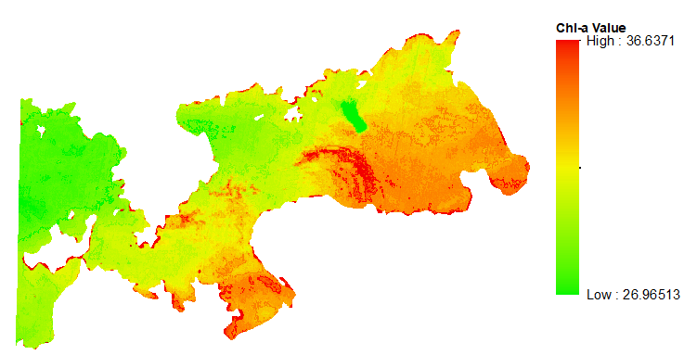
Results (b): High LSAT recorded during bloom Events
12th January 2015 23rd July 2016
04th August 2017 27th January 2018

Slide 16
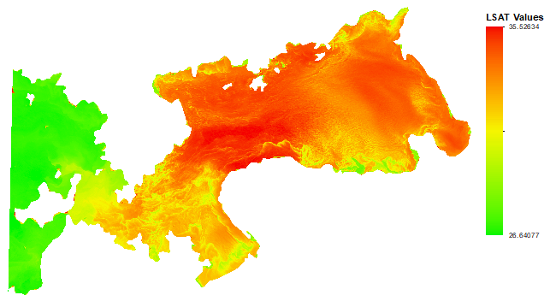
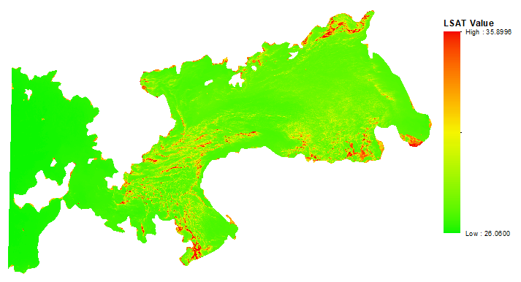
Results (b): High LSAT recorded during bloom Events
18th August 2019 29th August 2020

Slide 17
Accuracy assessment for LSAT Estimates
- Still having problems with getting a better reference data

Slide 18
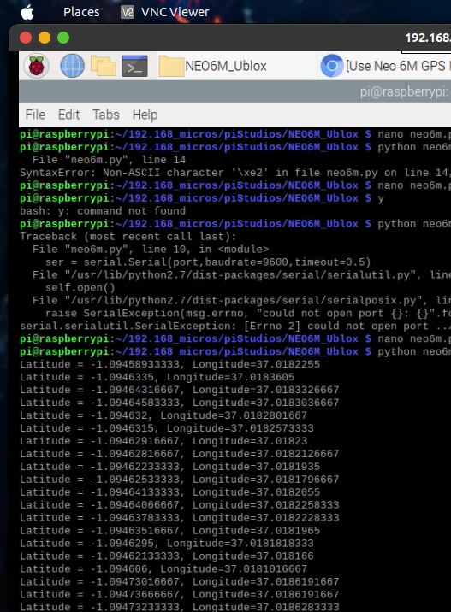
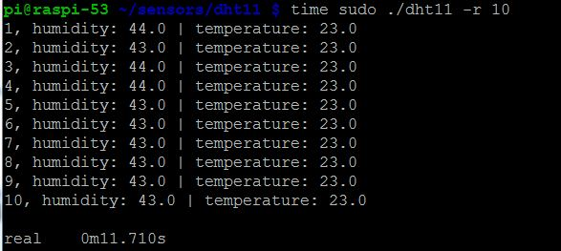
Obtaining GPS Location, Water Temp and Relative Humidity from Sensors.

Slide 19
Project Timeline
 | June - July | August | Sep | Oct | Nov | Dec
Chl-a | Literature Rev (Restructure) | Data Acquisition Preliminary results | Chl-a spatiotemporal Maps - Done
LSWT | Literature Rev (Restructure) |  | LSAT spatiotemporal Maps -Done
IoT | Literature Rev. Acquire all sensors | Unit tests | Long Range comm. |  | Full Data Acquisition and Dissemination

Slide 20

Thank you for your attention! Questions?

